Slide 1
Directing/Leading

Slide 2
Leading/Directing
It is defined as the process of influencing people so that they will contribute to organizational and group goals.
Managing requires the creation and maintenance of an environment in which individuals work together in groups toward the accomplishment of common objectives.
The manager’s job is not to manipulate people but, rather, to recognize what motivates people.

Slide 3
Human Factors in Managing
Through the function of leading, managers help people see that they can satisfy their own needs and utilize potential while contributing to the aims of the enterprise.
Managers should thus have an understanding of the roles assumed by people and the individuality and personalities of people.

Slide 4
Multiplicity of Roles
Individuals are much more than a productive factor in management’s plans.
They are members of social systems of many organizations; they are consumers of goods and services, schools, churches, trade associations, and political parties.
In these different roles, they establish laws that govern managers, ethics that guide behavior, and a tradition of human dignity that is a major characteristic of our society.

Slide 5
No Average Person
People act in different roles, but they are also different themselves.
There is no average person.
It is equally important to acknowledge that individuals are unique—they have different needs, different ambitions, different attitudes, different desires for responsibility, different levels of knowledge and skills, and different potentials.

Slide 6
The Importance of Personal Dignity
The concept of individual dignity means that people must be treated with respect, no matter what their position is in the organization.

Slide 7
Consideration of the Whole Person
We cannot talk about the nature of people unless we consider the whole person, not just separate and distinct characteristics such as knowledge, attitude, skills, or personality traits.
A person has them all to different degrees.
The human being is a total person affected by external factors.
People cannot divest themselves of the impact of these forces when they come to work.
Managers must recognize these facts and be prepared to deal with them.

Slide 8
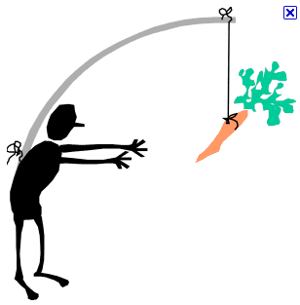
Motivation
A general term applying to the entire class of drives, desires, needs, wishes, and similar forces.

Slide 9
Motivation Models/Theories
Douglas McGregor’s Theory X and Theory Y
  Two sets of assumptions about the nature of people.
  Theory X is pessimistic, static, and rigid. Control is primarily external, imposed on the subordinate by the superior.
  In contrast, Theory Y is optimistic, dynamic, and flexible, with an emphasis on self-direction and the integration of individual needs with organizational demands.

Slide 10
Motivation Models/Theories
Under the assumptions of theory X:
Employees inherently do not like work and whenever possible, will attempt to avoid it.
Because employees dislike work, they have to be forced, coerced or threatened with punishment to achieve goals.
Employees avoid responsibilities and do not work fill formal directions are issued.
Most workers place a greater importance on security over all other factors and display little ambition.

Slide 11
Motivation Models/Theories
In contrast under the assumptions of theory Y:
Physical and mental effort at work is as natural as rest or play.
People do exercise self-control and self-direction and if they are committed to those goals.
Average human beings are willing to take responsibility and exercise imagination, ingenuity and creativity in solving the problems of the organization.
That the way the things are organized, the average human being’s brainpower is only partly used.

Slide 12
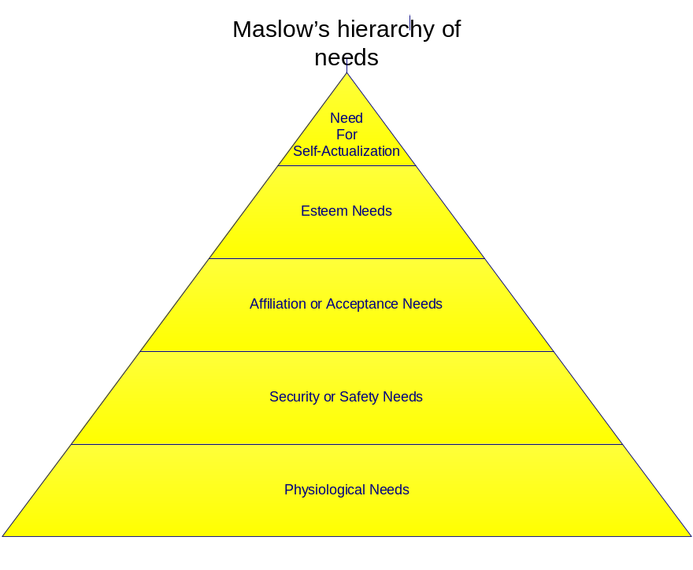
Motivation Models/Theories
Maslow’s Hierarchy of
Needs Theory
  When one set of needs is satisfied, this kind of need ceases to be a motivator.

Slide 13
Motivation Models/Theories
Clayton Alderfer’s ERG Theory
  People are motivated by existence needs, relatedness needs, and growth.
  Existence - concerned mainly with providing basic material existence.
  Relatedness - individuals need to maintain interpersonal relationship with other members in the group.
  Growth - the intrinsic desire to grow and develop personally.

Slide 14
Motivation Models/Theories
Frederick Herzberg’s Motivation-Hygiene Theory
  Satisfiers are motivators and are related to job content while dissatisfiers, also called maintenance, hygiene, or job-context factors, are not motivators.
  He states that presence of certain factors in the organization is natural and the presence of the same does not lead to motivation. However, their nonpresence leads to demotivation.
  In similar manner there are certain factors, the absence of which causes no dissatisfaction, but their presence has motivational impact.

Slide 15
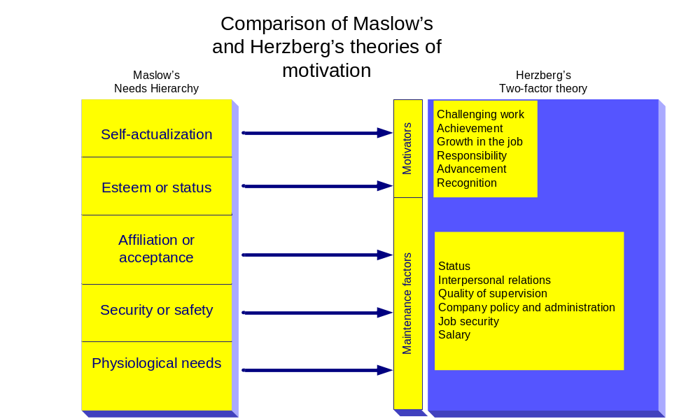
Motivation Models/Theories

Slide 16
Motivation Models/Theories
Vroom’s Expectancy Theory
  People will be motivated to do things to reach a goal if they believe in the worth of the goal and if they can see that what they do will help them in achieving it.
  An employee can be motivated to perform better when there is a belief that the better performance will lead to good performance appraisal and that this shall result into realization of personal goal in form of some reward

Slide 17
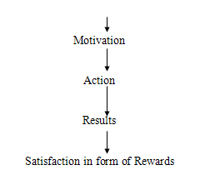
Motivation Models/Theories
Vroom’s Expectancy Theory
Motivation = Valence x Expectancy

Slide 18
Motivation Models/Theories
The Porter and Lawler Model
  Suggests that levels of motivation are based more on the value that individuals place on the reward.
  The components that effect motivation then, are called valence (what's important to you) and expectancy (can you do it).
  Porter and Lawler suggest that perceived inequality in this model plays a pivotal role in job satisfaction. Motivation or effort leads to performance. This performance is followed by intrinsic and extrinsic rewards. The perceived equity of those rewards leads to satisfaction.

Slide 19
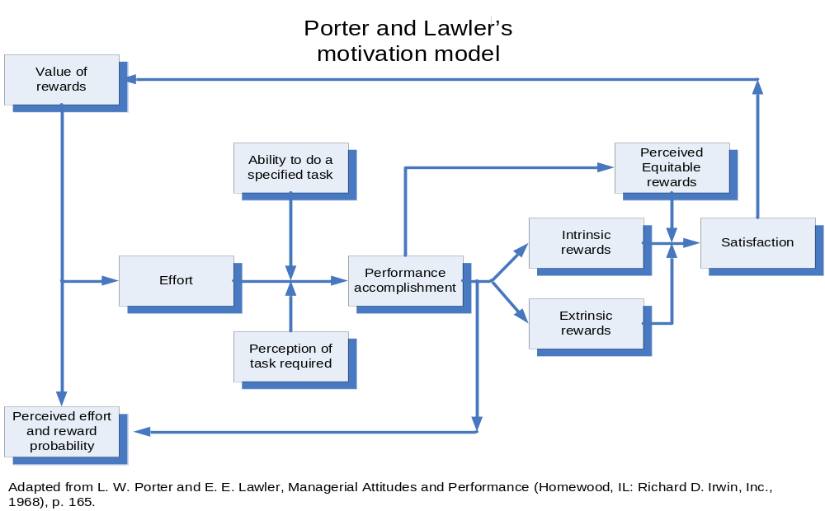
Motivation Models/Theories

Slide 20
Motivation Models/Theories
Equity Theory
  Motivation is influenced by an individual’s subjective judgment about the fairness of the reward he or she gets, relative to the inputs, compared with the rewards of others.
Reduced
Inequitable
Dissatisfaction
reward
output
organization
Departure from
Balance or
Equitable
Continuation
imbalance
reward
at same level
of rewards
of output
More than
Harder work
Equitable
Reward
reward
discounted

Slide 21

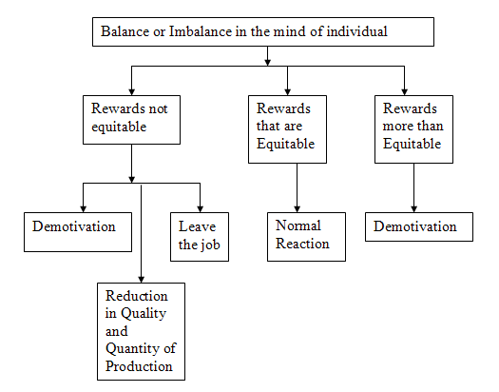
Motivation Models/Theories
Equity Theory

Slide 22
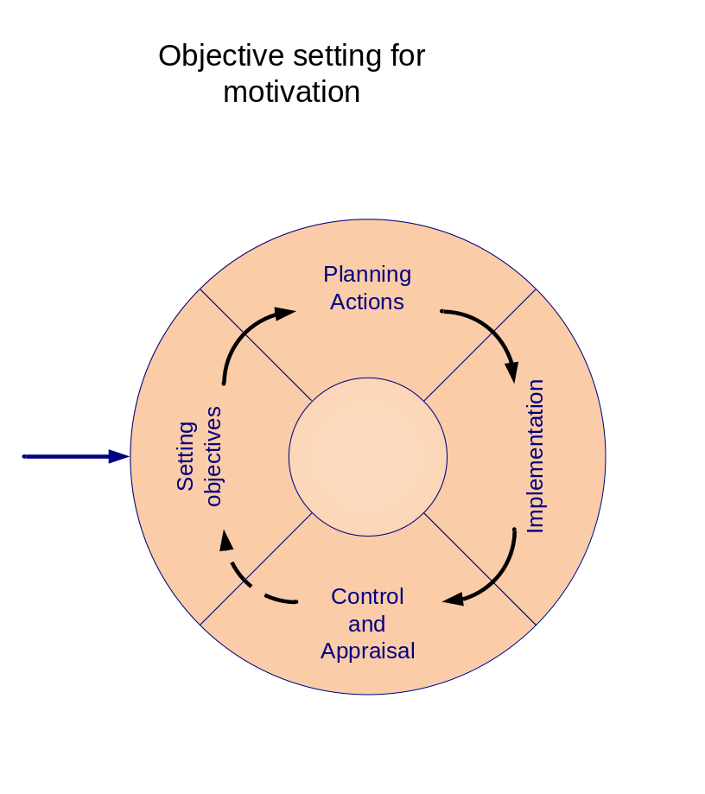
Motivation Models/Theories
Goal Setting Theory of Edwin Locke
States that when the goals to be achieved are set at a higher standard, employees are motivated to perform better and put in maximum effort.

Slide 23
Motivation Models/Theories
Skinner’s Reinforcement Theory
  Individuals can be motivated by proper design of their work environment and by praise for their performance, while punishment for poor performance produces negative results.
  Hence, the only way to motivate is to keep on making positive changes in the external environment of the organization.

Slide 24
Motivation Models/Theories
David McClelland’s Needs Theory
  a theory on three types of motivating needs which are
    Need for Power
    Need for Affiliation
    Need for Achievement

Slide 25

Motivation Models/Theories
People for high need for power are inclined towards influence and control, like to be at the center and are good orators, demanding in nature, forceful in manners and ambitious in life.
They can be motivated to perform if they are given key positions or power positions.

Slide 26
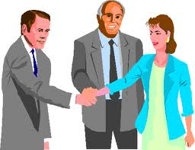
Motivation Models/Theories
People who are social in nature try to affiliate themselves with individuals and groups, are driven by love and faith, and like to build a friendly environment around themselves.
Social recognition and affiliation with others provides them motivation.

Slide 27

Motivation Models/Theories
People with the need of achievement are driven by the challenge of success and the fear of failure.
They set for themselves moderately difficult tasks, are analytical in nature and take calculated risks.
Such people are motivated to perform when they see atleast some chances of success.

Slide 28
Special Motivational Techniques
Intrinsic Motivation
  Refers to motivation that is driven by an interest or enjoyment in the task itself, and exists within the individual rather than relying on any external pressure
  It may include a feeling of accomplishment and self-actualization.

Slide 29
Special Motivational Techniques
Extrinsic Motivation
  Comes from outside of the individual. Common extrinsic motivations are rewards like money and grades, coercion (the practice of forcing another party to behave in an involuntary manner by use of threats, or rewards intimidation, or some other form of pressure or force), and threat of punishment.
  Include benefits, recognition, status symbols, and money. Competition is in general extrinsic because it encourages the performer to win and beat others, not to enjoy the intrinsic rewards of the activity.

Slide 30
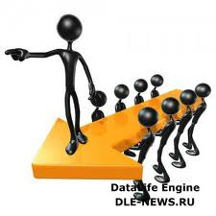
Leadership
Leadership is the art or process of influencing people so that they will strive willingly and
enthusiastically
toward the
achievement of
group goals.

Slide 31
Leadership
Good leaders are made not born. If you have the desire and willpower, you can become an effective leader. Good leaders develop through a never ending process of self-study, education, training, and experience.
- Jago, 1982

Slide 32
Ingredients of Leadership
Power
A fundamental understanding of people
The ability to inspire followers to apply their full capabilities
The leader’s style
The development of a conducive organizational climate

Slide 33
Approaches to Leadership
(1) Trait Approach
(2) Transformational and Transactional Leadership
(3) Charismatic Leadership
(4) Fiedler’s Contingency Approach
(5) Path-Goal Approach

Slide 34
(1) Trait Approaches to Leadership
Ralph M. Stogdill found that various researchers had identified specific traits related to leadership ability such as:
5 physical traits (such as energy, appearance, and height)
4 intelligence and ability traits
16 personality traits (such as adaptability, aggressiveness, enthusiasm, and self-confidence), 6 task-related characteristics (such as achievement drive, persistence, and initiative)
9 social characteristics (such as cooperativeness, interpersonal skills, and administrative ability)

Slide 35
(2) Transformational and Transactional
Leadership Approaches
The transformational leadership style occur when one or more persons engage in such a way that leaders and followers raise one another to higher levels of motivation and morality. This is almost like a synergy that might exist, whereby everyone gets raised to a higher level of performance.

Slide 36

(2) Transformational and Transactional
Leadership Approaches
Mahatma Gandhi (1869-1948) is a great example of a transformational leader because he satisfied the needs of his followers. Instead of riding those needs to power, he remained sensitive to a higher purpose.
His vision of leadership went beyond himself. He believed in satisfying the needs of all that followed him.

Slide 37
(2) Transformational and Transactional
Leadership Approaches
The transactional leadership theory, developed by Weber and Bass, is based on the hypothesis that followers are motivated through a system of rewards and punishment.
The transactional leader's view of the leader - follower relationship is one of quid pro quo - or this for that. If the follower does something good, then they will be rewarded. If the follower does something wrong, then they will be punished.

Slide 38
(3) Charismatic Leadership Approach
Charismatic leadership is based on the leader's ability to communicate and behave in ways that reach followers on a basic, emotional way, to inspire and motivate.
According to Robert J. House, charismatic leaders may have certain characteristics, such as:
  being self-confident
  having strong convictions
  articulating a vision
  being able to initiate change
  communicating high expectations
  having a need to influence followers and supporting them
  demonstrating enthusiasm and excitement
  being in touch with reality

Slide 39
(4) Fiedler’s Contingency Approach to Leadership
  People become leaders not only because of their personality attributes but also because of various situational factors and the interactions between leaders and group members.
  Based on leadership style --- task-motivated and relationship-motivated and situation --- leader-member relations, task structure, and position power.

Slide 40
(5 ) Path-goal Approach to Leadership
This was developed to describe the way that leaders encourage and support their followers in achieving the goals they have been set by making the path that they should take clear and easy.
In particular, leaders:
  Clarify the path so subordinates know which way to go.
  Remove roadblocks that are stopping them going there.
  Increasing the rewards along the route.

Slide 41
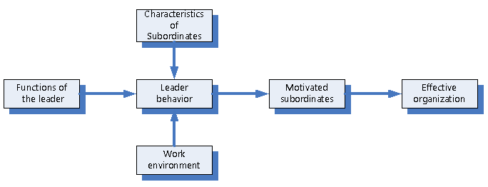
(5 ) Path-goal Approach to Leadership

Slide 42
Leadership Styles Based on Use of Authority
Autocratic Leader
  He commands and expects compliance, is dogmatic and positive, and leads by the ability to withhold or give rewards and punishment.
Democratic or Participative Leader
  He consults with subordinates and encourages their participation.
Free-rein Leader
  He uses power very little, if at all, giving subordinates a high degree of independence.

Slide 43
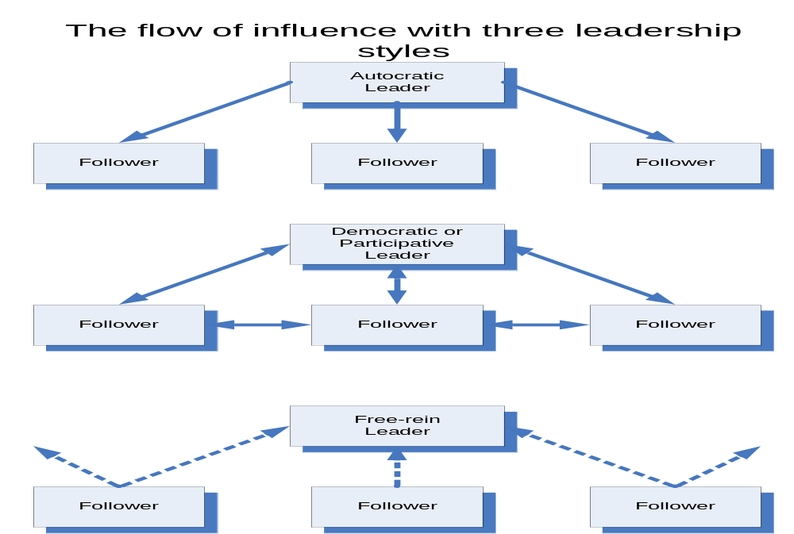
Leadership Styles Based on Use of Authority

Slide 44
The Managerial Grid
A well-known approach to defining leadership styles is the managerial grid, developed decades ago by Robert Blake and Jane Mouton.
The managerial grid has two dimensions: concern for people and concern for production.
Blake and Mouton recognizes five style: 1.1 style, 9.9 style, 5.5 style, 1.9 style, and 9.1 style.

Slide 45
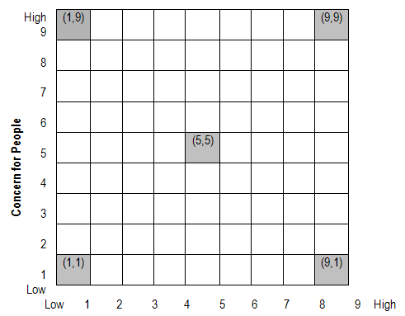
The Managerial Grid

Slide 46
The Managerial Grid
The five resulting leadership styles are as follows:
Impoverished Management (1, 1)
  Managers with this approach are low on both dimensions and exercise minimum effort to get the work done from subordinates.
  The leader has low concern for employee satisfaction and work deadlines and as a result, disharmony and disorganization prevail within the organization.
  The leaders are termed ineffective wherein their action is merely aimed at preserving job and seniority.

Slide 47
The Managerial Grid
Task management (9, 1)
  Leaders are more concerned about production and have less concern for people.
  The style is based on theory X of McGregor. The employees’ needs are not taken care of and they are simply a means to an end.
  The leader believes that efficiency can result only through proper organization of work systems and through elimination of people wherever possible. Such a style can definitely increase the output of organization in short run but due to the strict policies and procedures, high labor turnover is inevitable.

Slide 48
The Managerial Grid
Middle-of-the-Road (5, 5)
  Basically a compromising style wherein the leader tries to maintain a balance between goals of company and the needs of people.
  The leader does not push the boundaries of achievement resulting in average performance for organization.
  Here neither employee nor production needs are fully met.

Slide 49
The Managerial Grid
Country Club (1, 9)
  This is a collegial style characterized by low task and high people orientation where the leader gives thoughtful attention to the needs of people thus providing them with a friendly and comfortable environment.
  The leader feels that such a treatment with employees will lead to self-motivation and will find people working hard on their own.
  However, a low focus on tasks can hamper production and lead to questionable results.

Slide 50
The Managerial Grid
Team Management (9, 9)
  Characterized by high people and task focus, the style is based on the theory Y of McGregor and has been termed as most effective style according to Blake and Mouton.
  The leader feels that empowerment, commitment, trust, and respect are the key elements in creating a team atmosphere which will automatically result in high employee satisfaction and production.

Slide 51
Communication
The transfer of information from a sender to a receiver, with the information being understood by the receiver.

Slide 52
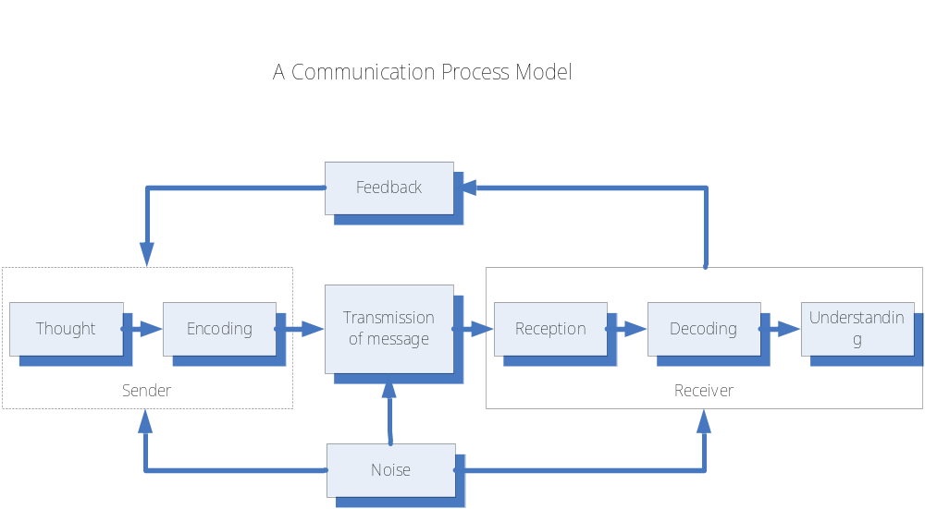
The Communication Process

Slide 53
The Purpose of Communication
To establish and disseminate the goals of an enterprise.
To develop plans for their achievement.
To organize human and other resources in the most effective and efficient way.
To select, develop, and appraise members of an organization.
To lead, direct, motivate, and create a climate in which people want to contribute.
To control performance.

Slide 54
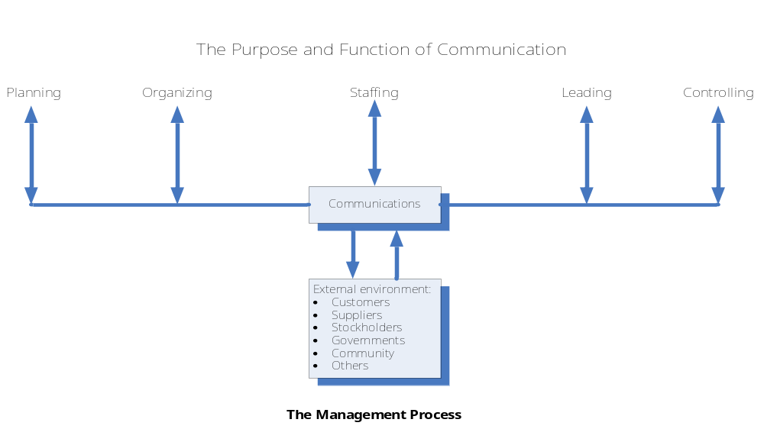
The Communication Process

Slide 55
Communication in an Organization
Downward Communication
  It flow from people at higher levels to those at lower levels in the organizational hierarchy.
Upward Communication
  Travels from subordinates to superiors and continues up the organizational hierarchy.
Crosswise Communication
  It includes the horizontal flow of information (among people on the same or similar organizational levels) and the diagonal flow of information (among people at different levels who have no direct reporting relationships with one another).

Slide 56
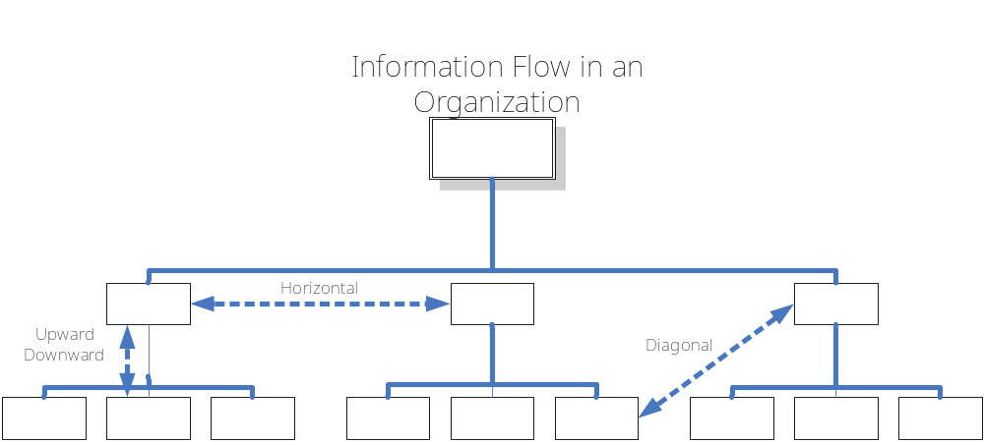
Communication in an Organization

Slide 57
Forms of Communication
Written Communication
  Communication in written form
  Includes pictograms or visuals, letters, memorandums, reports, text messages, electronic messages (e-mail).

Slide 58
Forms of Communication
Oral or verbal Communication
  Primarily refers to spoken verbal communication
  Includes discussion, speeches, presentations, interpersonal communication and many other varieties.
  The body language and voice tonality plays a significant role and may have a greater impact on the listener than the intended content of the spoken words.

Slide 59
Forms of Communication
Nonverbal Communication
  Describes the process of conveying meaning in the form of non-word messages through e.g. gestures, body language, or posture; facial expression and eye contact, object communication such as clothing, hairstyles, architectures, symbols, and infographics, as well as through an aggregate of the above.
  Non-verbal communication is also called silent language and plays a key role in human day to day life.

Slide 60
Communication Methods
Primitive or conventional method
  regular mail (“snail mail”), morse code
Use of information technology
  wired and wireless telephone, fax machine, voice mail, internet (for e-mail, chatting, etc), teleconference , and videoconference

Slide 61
Tips for Improving Written Communication
Use simple words and phrases.
Use short and familiar words.
Use personal pronouns (such as “you”) whenever appropriate.
Give illustrations and examples; use charts.
Use short sentences and paragraphs.
Use active verbs, such as “The manager plans…”
Avoid unnecessary words.

Slide 62
Tips for Improving Oral Communication
Communicate with a large audience as you would do in a one-to-one conversation.
Tell a story, an anecdote, and give examples.
Pause—do not rush. In a discussion, a pause shows that you are listening.
Use visual aids such as diagrams, charts, overhead slides, and computer graphic presentations.
Communicate confidence and create trust. This can be done by strong and clear voice, good posture, and a smile.
Use a colorful, specific language and show through your body language that you are confident and are in command of the situation.

